Slide 1
Heart Disease EDA
Dataset source
https://www.kaggle.com/datasets/kamilpytlak/personal-key-indicators-of-heart-disease

Slide 2
Key points of the analysis:
-Identify the most vulnerable population
-Identify the most common health issues
-Distributed between ages and sexes

Slide 3
Methodology-Data cleaning
-Delete empty entries
-Use correlation algorithm to establish relevant variables
-converted categorical data using numerical mapping

Slide 4
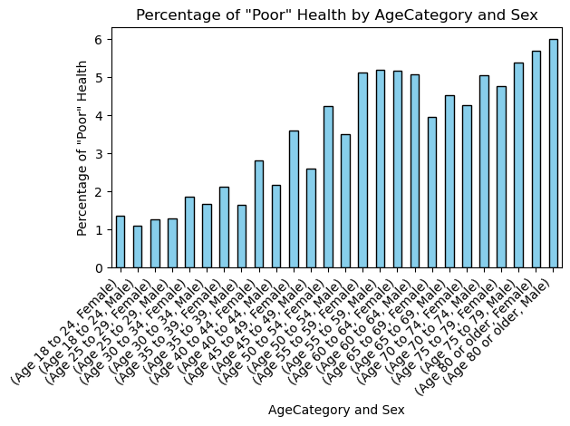

Slide 5
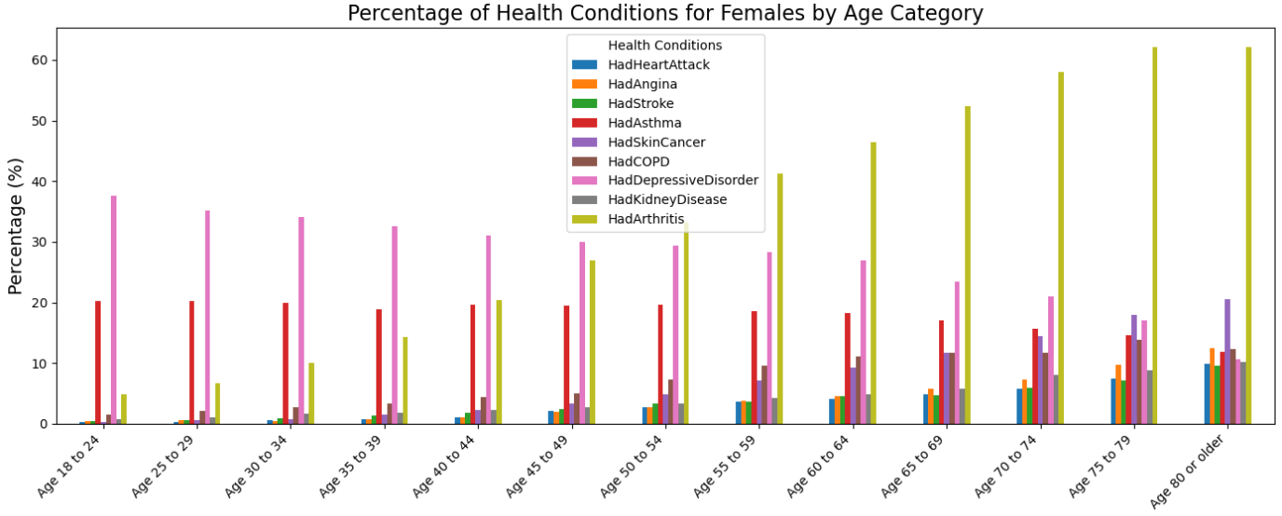
Main issues for females by age

Slide 6
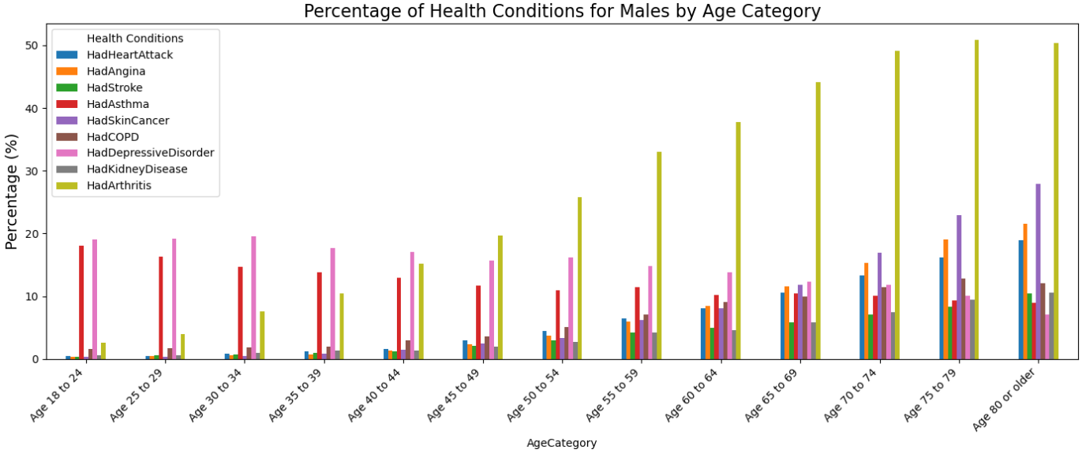
Main issues for males by age

Slide 7
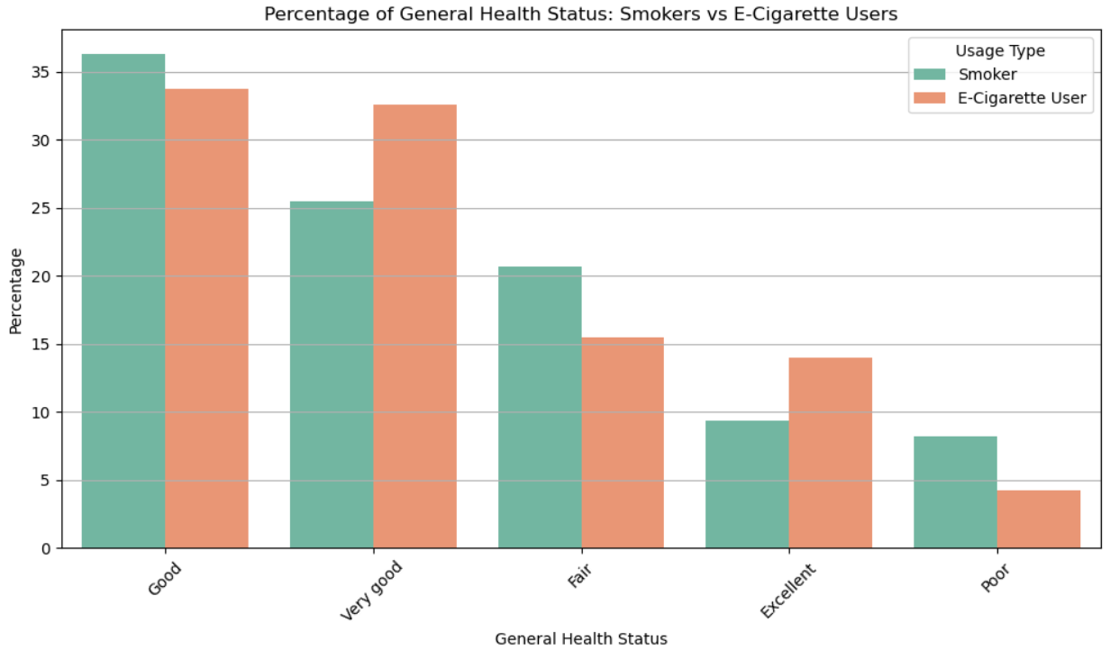
Comparison between smokers and e-cigarette users on general health

Slide 8
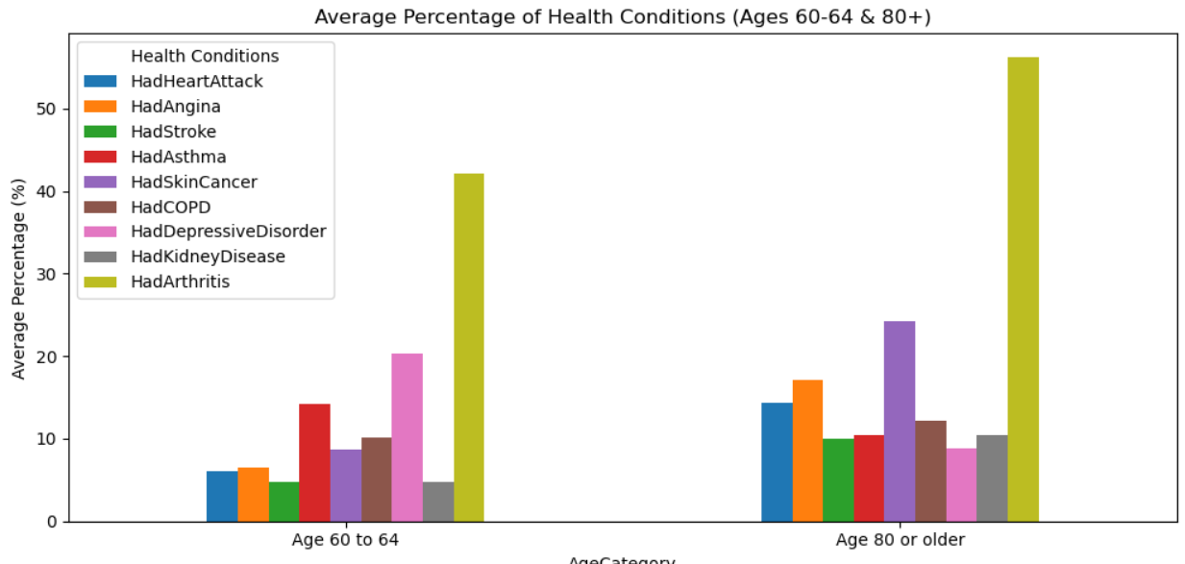
Comparison between age 60-64 and age 80+ on health issues

Slide 9
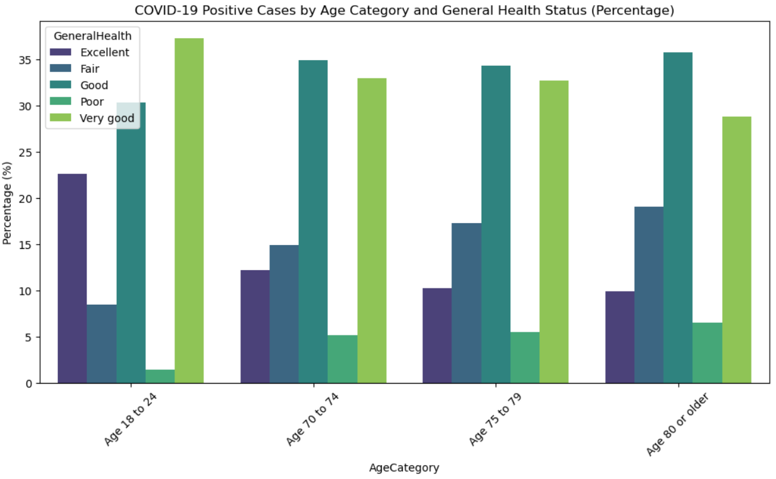
General health status after COVID-19 infection

Slide 10
Conclusions
-the group of aged 80+ appear to have poorest health marks
-Younger people suffer mostly from depression especially women
-most common health issue is arthitris for people over 60 age
-overall e-cigarettes users have better health mark than smokers

